Slide 1
Environmental Modelling
Münster 2014
Prof. Dr. Tiago G. S. Carneiro

Slide 2
NO

Slide 3
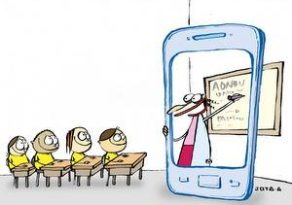
YES

Slide 4
Course Online
www.terralab.ufop.br
www.terrame.org
tiagogsc@gmail.com → Subject: [munster] bla bla bla...
I WILL NOT SOLVE ISSUES OR ANSWER QUESTIONS BY E-MAIL
EMAIL ME TO BOOK GROUP MEETINGS or
GIVE ME NOTICES ABOUT MISSING CLASSES
YOU MAY MISS ONLY TWO CLASSES!!! BE AWARE...

