Slide 1
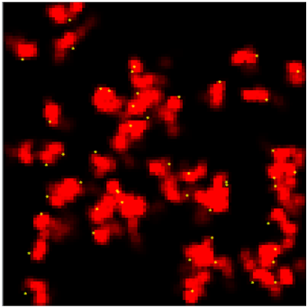
HEATBUGS
Ondrej Zvara
Linda Riquelme

Slide 2
What is it?
Agent-based model: global effects of individual/local interactions
“Heatbugs” inspired by behaviour of biological agents
Constant agent-environment interaction
Self-organising group processes
Emergent properties result from complex system behaviour

Slide 3
Why is it relevant?
Ecology: Biological agents
Model environmental effects on individuals and emergent behavior within a population

Slide 4
How does it work?
Environment: grid of square “patches”
Bugs move to adjacent empty “patch”
Bugs have ideal temperatures
They emit heat, which is dispersed through environment
Some heat lost to cooling
If they’re unhappy, they move

Slide 5
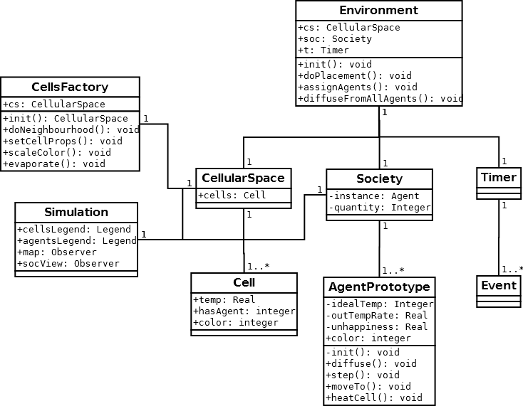
Implementation

Slide 6
Parameters
Space parameters:
INITCELLTEMP
SPACE_DIMENSION
Cell parameters:
EVAPORATIONRATE
SOCIETY_SIZE

Slide 7
Parameters
Agent parameters:
MINIDEALTEMP
MAXIDEALTEMP
MINOUTPUTHEAT
MAXOUTPUTHEAT
DIFFUSIONRATE
RANDOMMOVECHANCE

Slide 8
Demonstration

Slide 9
Things to note
Bugs clump or spread, depending on environmental temperature
Bugs become unhappy when temperature is too high

Slide 10
Things to try
Change initial number of bugs
Change parameters:
EVAPORATIONRATE
DIFFUSIONRATE

Slide 11
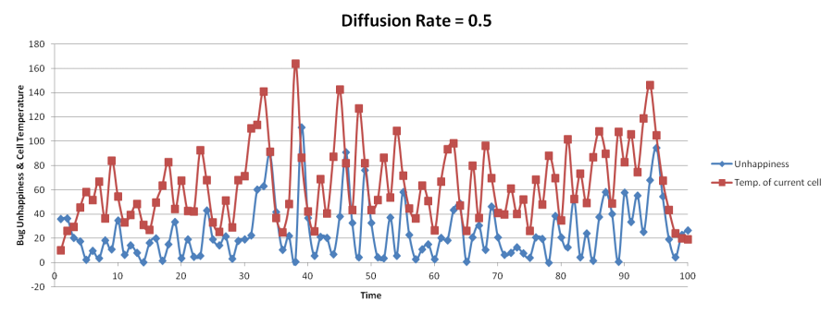
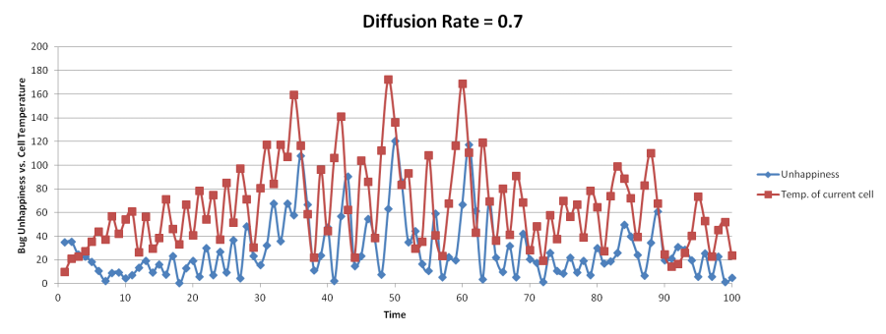
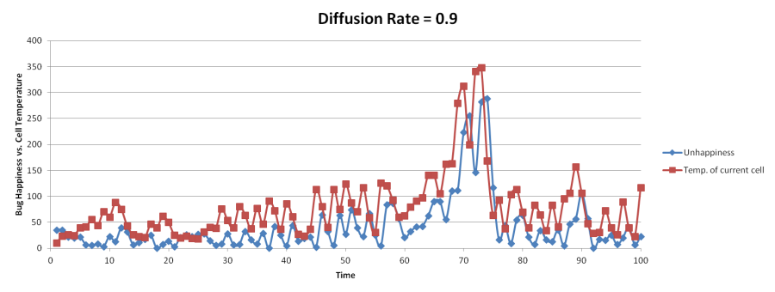
DIFFUSIONRATE

Slide 12
References
Beer, R.D. (1995). A dynamical systems perspective on interaction. Artificial Intelligence 72:173-215
Grimm, V., Revilla, E., Berger, U., Jeltsch, F., Mooij, W.M., Railsback, S.F., Thulke, H.-H., Weiner, J., Wiegand, T. & DeAngelis, D.L. (2005). Pattern-Oriented Modeling of Agent-Based Complex Systems: Lessons from Ecology. Science 310:987-991
Macy, M.W. & Willer, R. (2002). From factors to actors: Computational sociology and agent-based modeling. Annu. Rev. Sociol., 28:143-166
Scholl, H.J. (2001). Agent-based and system dynamics modeling: a call for cross study and joint research. In System Sciences, 2001. Proceedings of the 34th Annual Hawaii International Conference on IEEE, 8-pp.
Wilensky, U. (2004). NetLogo Heatbugs model. http://ccl.northwestern.edu/netlogo/models/Heatbugs. Center for Connected Learning and Computer-Based Modeling, Northwestern University, Evanston, IL., USA.

Slide 13
Thank you

