Slide 1
Summary
Pedro R. Andrade
Gilberto Camara

Slide 2
Environmental Modeling Course
Computer simulation of environmental processes
Different approaches
Systems theory
Cellular automata
Agent-based modeling

Slide 3
Systems Dynamics
Any measurable part of reality can be modeled
Systems are represented as stocks and flows
Stocks represent energy, matter, or information
Flows connect and transport stocks
Inflow
Stock
Outflow

Slide 5
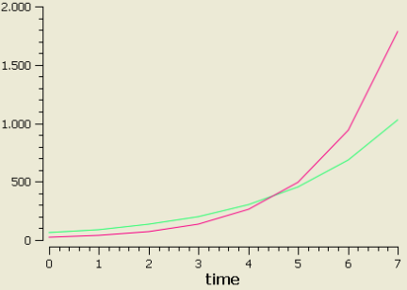
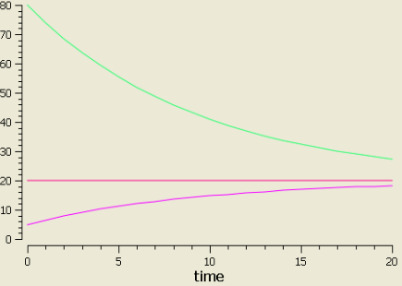
Feedbacks
Reinforcing
Balancing

Slide 6
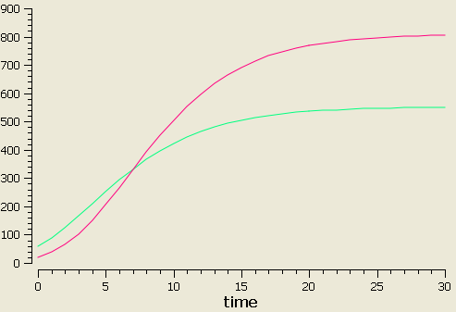
Limits to Growth

Slide 7
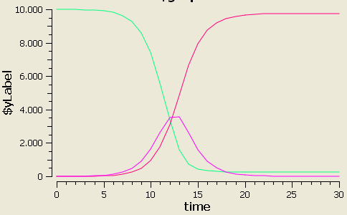
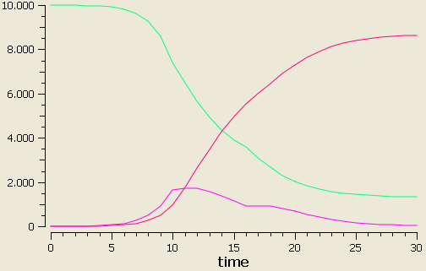
Scenarios
Normal situation
Educational campaign to avoid contacts

Slide 8
System Dynamics
Advantages
Simple representation of the world
Modular and hierarchical
Can be used to model the whole Earth
Disadvantages
No heterogeneity
Fixed connections between stocks
Implicit spatial representation

Slide 9
Basic Cellular Automaton
Grid of cells
Neighbourhood
Finite set of discrete states
Finite set of transition rules
Initial state
Discrete time

Slide 10
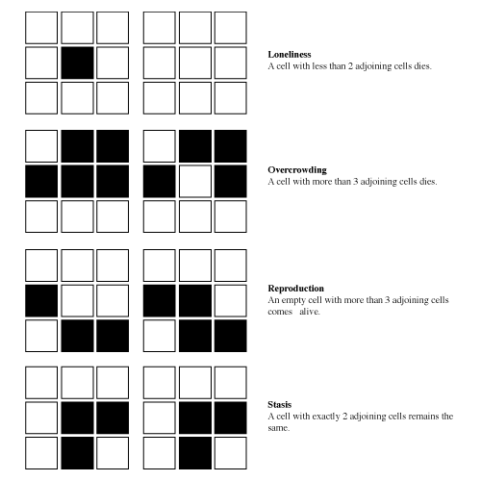
Game of life

Slide 11
Synchronization
With synchronization
Without synchronization

Slide 12
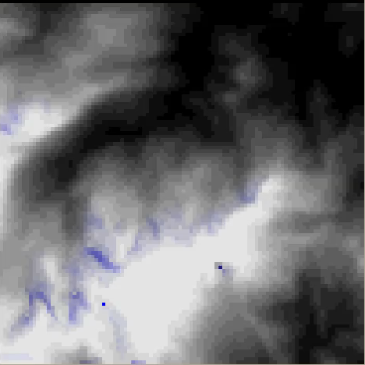
Cellular automata models
Fire in the forest
Runoff

Slide 13
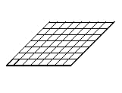
Top-down Land Change Models
Input data
Demand submodel
How much?
Transition potential
submodel
Where?
Change allocation
submodel
Land use at t
Time loop
Land use at t+1

Slide 14
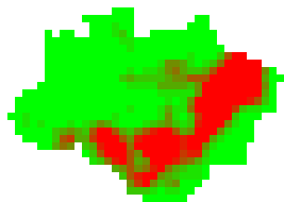
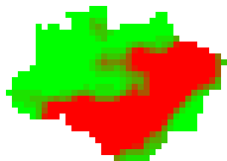
Land Change models
Yearly demand = 30,000km²
Yearly demand = 60,000km²

Slide 15
Cellular Automata
Advantages
Spatially explicit
Applicable to physical processes
Can deal with considerably large areas
Models can be replicated to other study areas
Disadvantages
Consider one single process
Fixed relations
To model human actions it has to anthropomorphize states

Slide 16
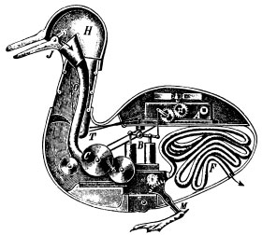
Agent-based modelling (ABM)
Bottom-up approach for building complex systems, through the dynamical interaction of agents.
flexibility
natural approach
emergence
An agent is any actor within an environment, any entity that can affect itself, the environment and other agents.

Slide 17
Agent-based models
Traditional Tools | Agent-based Models
Precise | Flexible
Little process | Process oriented
Timeless | Timely
Optimizing | Adaptive
Static | Dynamic
1, 2, ..., ∞ agents | 1, 2, ..., N agents
Vacuous | Spacely/Networked
Homogeneous | Heterogeneous
Source: Miller and Page (2007)
Notes:
Miller and Page, Complex Adaptive Systems: An Introduction to Computational Models of Social Life, 2007, p.79.

Slide 18
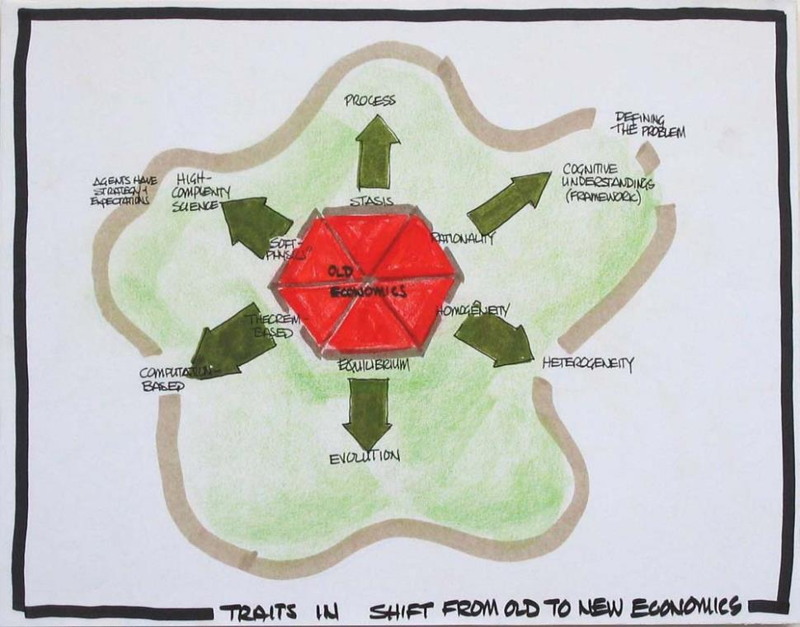
Source: http://www.leggmason.com/thoughtleaderforum/2004/conference/transcripts/arthur_trans.asp

Slide 19
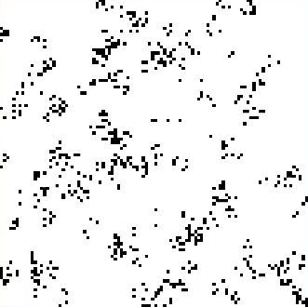
Simple agent-based models

Slide 20
ABM
Advantages
Flexibility
Applicable to human processes
Spatial and behavioural heterogeneity
Relations can change
Disadvantages
Development takes time
Many assumptions
Usually applied to small regions
Usually not replicable to other study areas

Slide 21
Final Remarks
Every approach has advantages and disadvantages
The assumptions are more important than the results
Beware: modeling can be seductive [1]
[1] Lahsen (2005) Seductive simulations? Uncertainty distribution around climate models. Social Studies of Science, 35(6):895-922

Slide 22
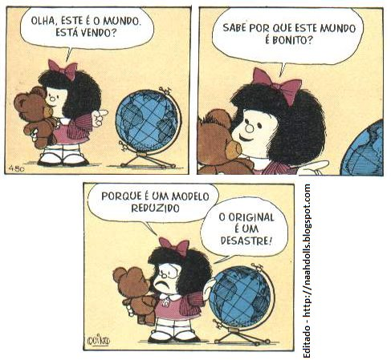
Final Remarks

Slide 23
A Storyteller
Simulation models tell a story
It can be about the present, past, or future…
The story might or not be good…
But if offers another way to look at a given problem
TOOL TO SHARE VISIONS, GIVE RISE TO DOUBTS, AND TO PROMOTE DISCUSSIONS
Source: (Feitosa, 2012)
Notes:
Source: Feitosa (2012)
Metáfora adaptada de Guhathakurta (2001)
Guhathakurta S, 2002, "Urban modeling as storytelling: using simulation models as a narrative" Environment and Planning B: Planning and Design 29(6) 895 – 911

