Slide 1
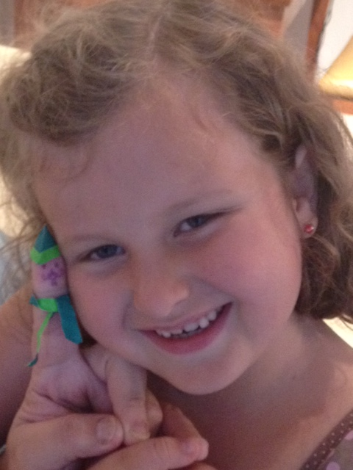
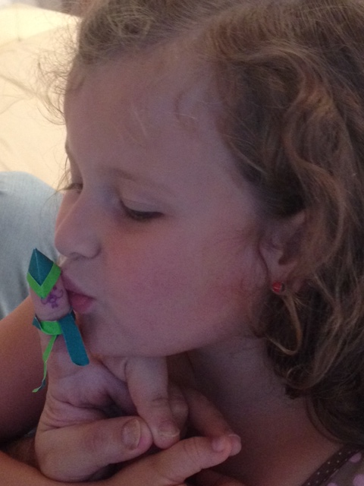
Mr. Worm is being Cecília’s friend since she was 2 years old

Slide 2
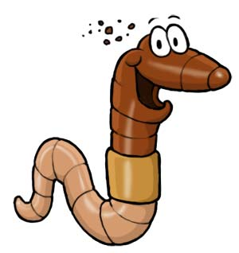
To teach her programming we start to play with Mr. Worm in Lua language
The first idea was to print the names of parts of Mr. Worm’s body:
print(“head”)
print(“ring”)
print(“tail”)

Slide 3
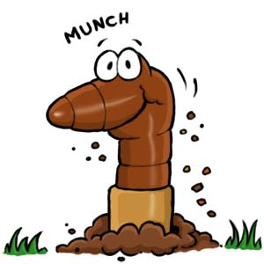
Later we realized that Mr. Worm has many rings. But, one is special.
Then, the program become:
print(“head”)
print(“ring”)
print(“special ring”)
print(“ring”)
...
print(“ring”)
print(“tail”)

Slide 4
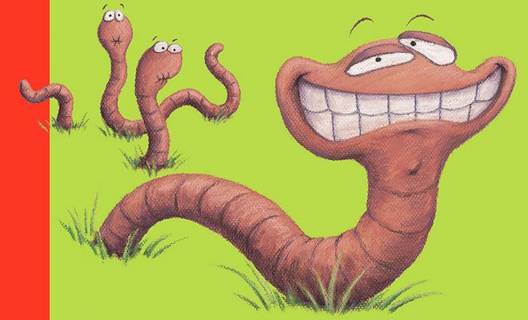
Is there an easy way to make Mr. Worm very, very, very...long?
Of course there is Cecília! Let’s do it using a loop instruction:
But dad! You forgot the special ring?
print(“head”)
for n = 1, 100 do
print(“ring”)
end
print(“tail”)
print(“head”)
for n = 1, 100 do
if( n == 2 ) then
print(“special ring”)
else
print(“ring”)
end
end
print(“tail”)

Slide 5
Dad. Let’s make a train with several Mr. Worms?
Cut and past... the brute-force way:
1. print(“head”)
2. for n = 1, 100 do
3. if( n == 2 ) then
4. print(“special ring”)
5. else
6. print(“ring”)
7. end
8. end
9. print(“tail”)
10. ---------------------------------
11. print(“head”)
12. for n = 1, 100 do
13. if( n == 2 ) then
14. print(“special ring”)
15. else
16. print(“ring”)
17. end
18. end
19. print(“tail”)
20. ---------------------------------
21. print(“head”)
22. for n = 1, 100 do
23. if( n == 2 ) then
24. print(“special ring”)
25. else
26. print(“ring”)
27. end
28. end
29. print(“tail”)
30. ---------------------------------
31. print(“head”)
32. for n = 1, 100 do
33. if( n == 2 ) then
34. print(“special ring”)
35. else
36. print(“ring”)
37. end
38. end
39. print(“tail”)
40. ---------------------------------

Slide 6
Dad. Let’s make a train with several Mr. Worms?
Modularity... Find out a pattern, give a name it, and reuse it:
1. function MrWorm( )
2. print(“head”)
3. for n = 1, 100 do
4. if( n == 2 ) then
5. print(“special ring”)
6. else
7. print(“ring”)
8. end
9. end
10. print(“tail”)
11. end
12.
13. for n = 1, 4 do
14. MrWorm( )
15. end

Slide 7
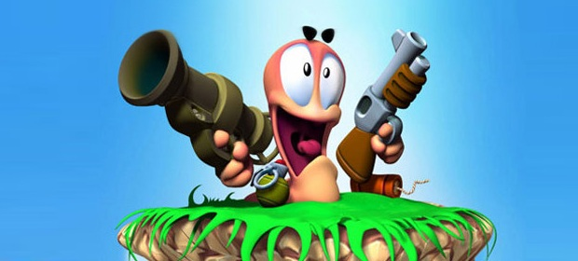
_ Dad.... _ Uhm... _ Stoooop it!!!

Slide 8
