Slide 1
TERMITE model
Colin Broderick
Stjepan Rajcic

Slide 2
The termites wander around randomly until they hit a wood chip
When the hit a wood chip they pick it up and move randomly away from that place
When the termite hits another wood chip it will drop the wood chip beside that one and move to another random place

Slide 3
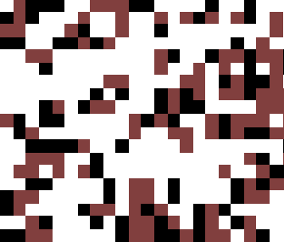

Slide 4
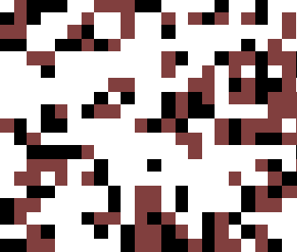

Slide 5
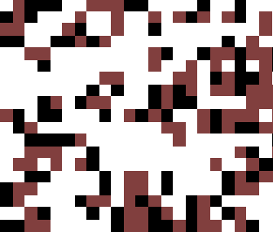

Slide 6
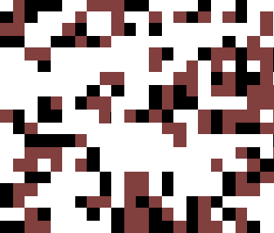

Slide 7
Model simulates the movement of termites as they pick up wood chips in a space
Set the Grid Size
Set the number of Termites (agents)
Set the percentage of randomly distributed Wood Chips

Slide 8
Define environment (cellular space, society (agents) and timer)
Define neighborhood: moore
Observer and legend

Slide 9
Conclusion
Termites – agents in cellular space
Clustering effect
Speed of clustering depends on the input parameters
Potential further developments

